Slide 1
China Limits European Contact

Slide 2
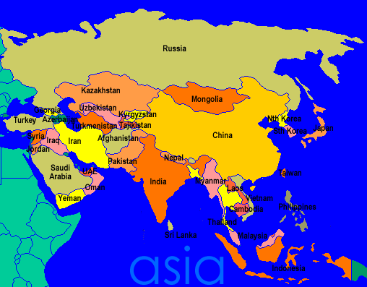

Slide 3
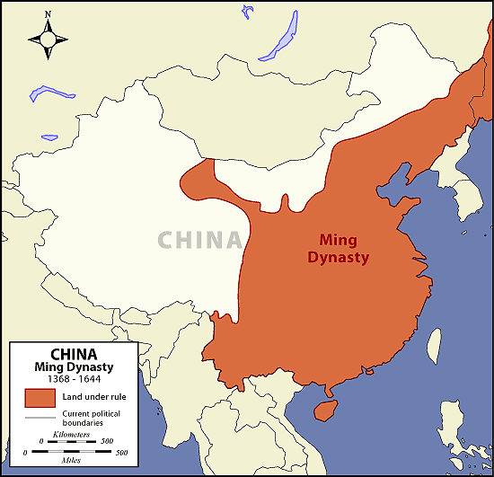
Ming Dynasty (1368 – 1644)

Slide 4
The Ming Dynasty
1368 – Hongwu commands Chinese army that drives Mongols out of China. (1st Ming Emperor)
1. Agriculture reforms = increase in population
2. Return of Chinese society to Confucian morals.
3. Civil Service Reforms – Exams given for government jobs
Early 1400’s: China launches seven voyages of exploration throughout Southwest Asia and Africa.
Voyages demonstrated the wealth and power of Ming dynasty
Voyages consisted of hundreds of ships and thousands of men (floating cities)
Zheng He led all seven voyages

Slide 5
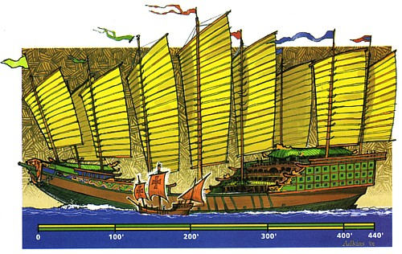
Ming Treasure Ship vs. Columbus Ship

Slide 6
1433 China follows policy of isolationism
Capital moved to Beijing – Palace was called the “Forbidden City” because peasants and foreigners were not allowed to enter.
Government controlled all trade – Goods only could enter/exit through 3 ports (smuggling)
Demand for porcelain and silk. Heavy taxes on manufactured goods causes China to remain an agricultural country

Slide 7
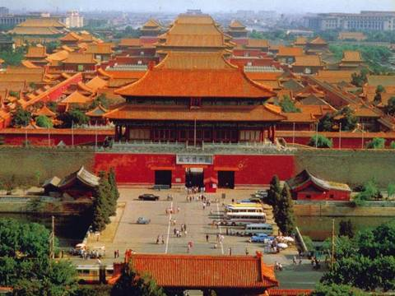
The Forbidden city

Slide 8
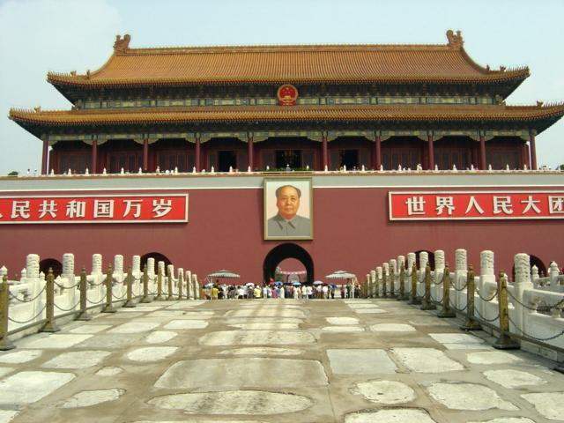

Slide 9
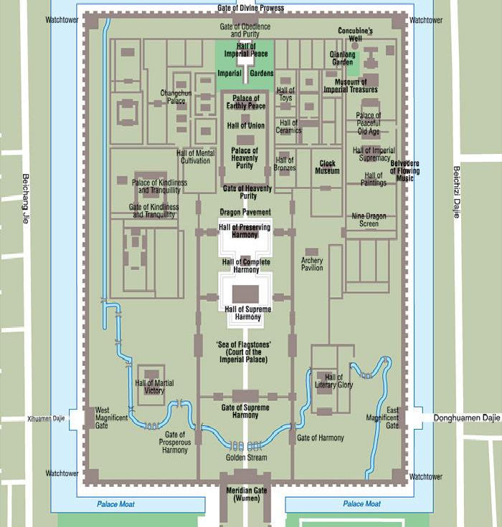

Slide 10
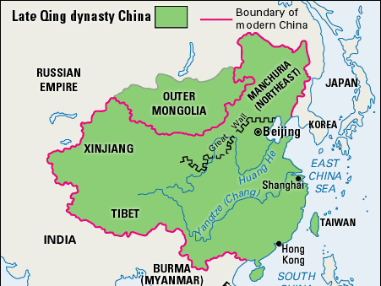
Qing Dynasty
(1644 – 1912)

Slide 11
The Qing Dynasty
1644 Manchus invade China and seize Beijing
Took the Chinese name Qing Dynasty
Eventually gained citizens respect:
1. Upheld Confucian beliefs
2. Made frontiers safer
3. Restored Chinese prosperity
Reduced government spending and lowered taxes
Welcomed intellectuals and Jesuits into their court
Trade/ Commerce
Restrictions: Special Ports & Paying Tribute
Dutch accepted terms – English did not accept

Slide 12
Chinese Inventions
Compass
Gunpowder
Wheelbarrow
Seismoscope (Earthquake Detector)
Kites
Noodles
Block Printing
Mines (Land and Naval)
Lottery

Slide 13
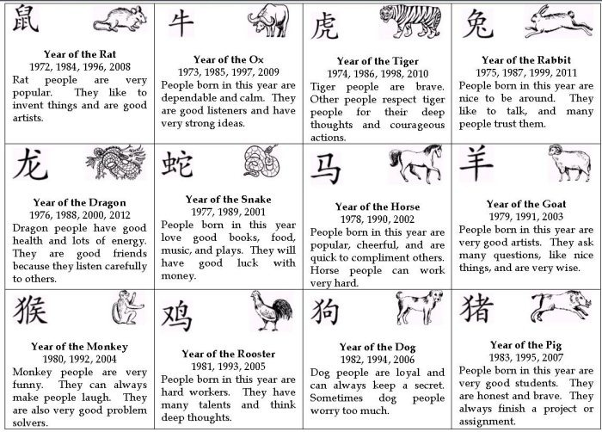
Chinese Zodiac

Slide 14
Buddhism
Founder: Buddha “the Enlightened One”, born in India
Religion is over 2,500 years old
Found in Sri Lanka, East and S.E Asia and Japan
Buddha did not teach a personal deity
There is no one Holy Book
Leadership comes from Buddhist monks and nuns
Beliefs
Dharma: Key to happiness was detachment from worldly desires.
Rebirth: Living things after death are reborn
Meditation: A form of religious contemplation
Goal: NIRVANA – complete peace and happiness

Slide 15
The Eightfold Path
1. Know the truth
2. Intend to resist evil
3. Not say anything to hurt others
4. Respect life, property and morality
5. Work at a job that does not injure others
6. Free ones mind from evil
7. Be in control of ones feelings and thoughts
8. Practice appropriate forms of concentration

