Slide 1
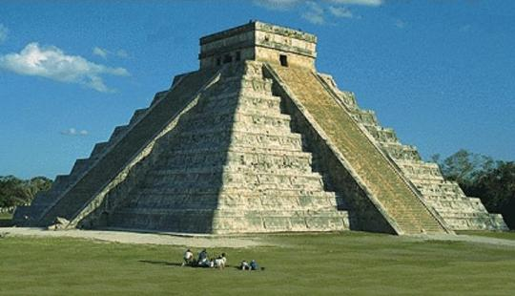
Maya, Aztec, and Inca Civilizations

Slide 2
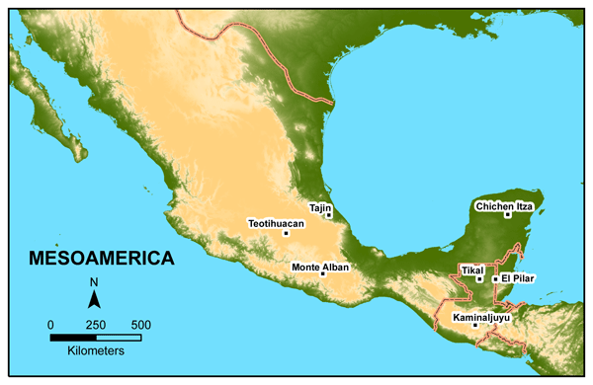
Mesoamerica
Mesoamerica = Mexico & Central America

Slide 3
Mesoamerica
Some of the earliest civilizations in the Americas developed in Mesoamerica
The Maya and Aztec lived in the Mesoamerican region

Slide 4
How did people first get to the Americas?
Theory #1 = Bering land bridge
Humans migrated into North America from Asia by crossing over a land bridge between Alaska and Siberia…

Slide 5
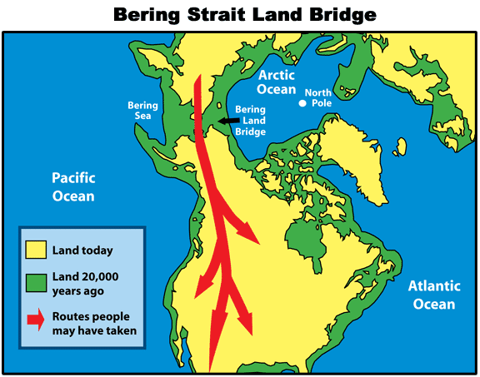

Slide 6
How did people first get to the Americas?
Theory #2 = Coastal migration
Humans migrated to the Americas by crossing the seas, most likely the Pacific Ocean, and settling along the western coasts of the Americas…

Slide 7
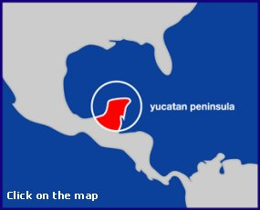
Where did the ancient Maya live?
The Maya were concentrated on and around the Yucatan Peninsula in central America.

Slide 8
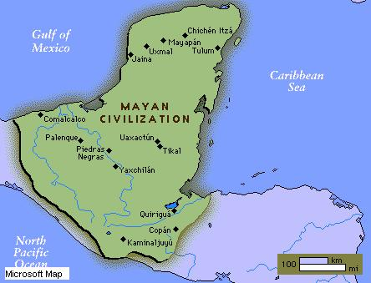

Slide 9
Maya Political Structure
The Maya were NOT AN EMPIRE and NOT UNITED politically…
Maya civilization was made up of city-states
Each city-state had its own ruler

Slide 10
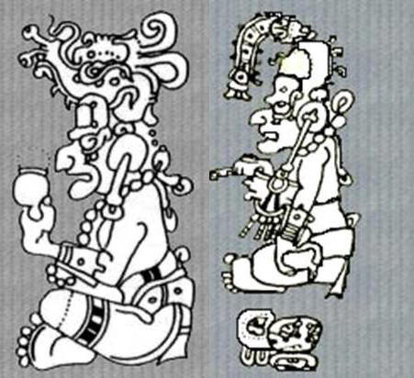
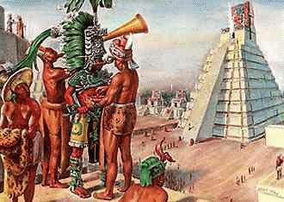
Maya Religion
The Maya were polytheistic
The Maya practiced human sacrifice

Slide 11
Maya Architecture
The Maya built towering temples and elaborate palaces
Atop the temples, priests performed religious ceremonies and sacrifices while people watched from the plazas below
Ceremonial platforms, temples, pyramids, observatories, ball courts all built by the Maya

Slide 12
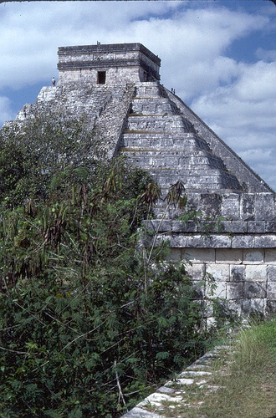
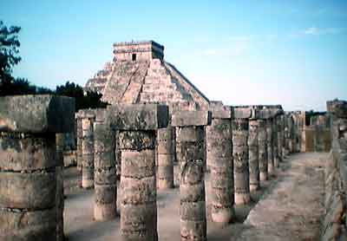
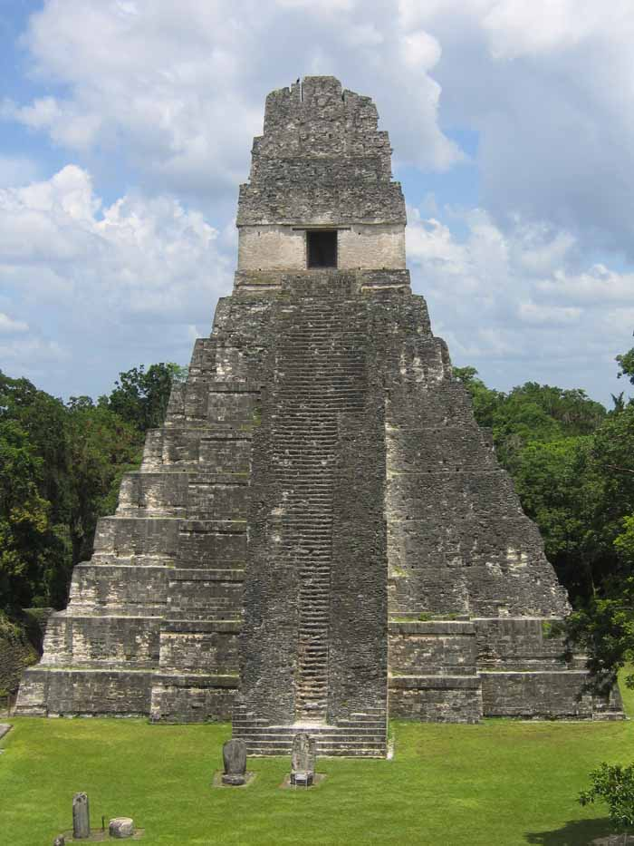

Slide 13
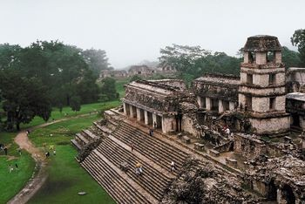
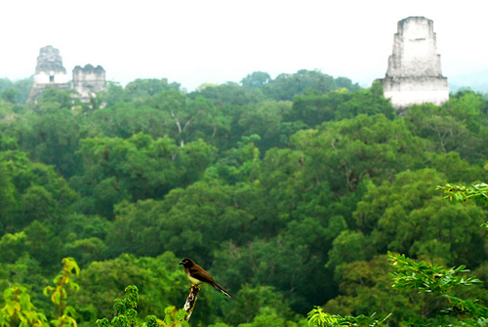
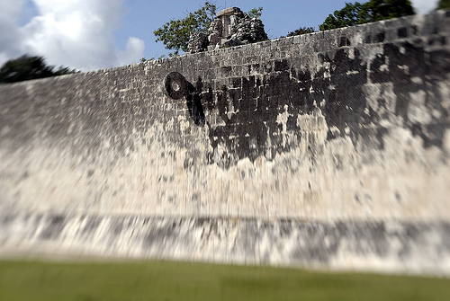

Slide 14
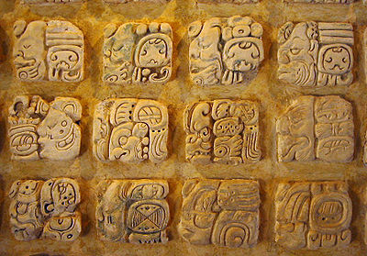
Advances in learning
The Maya created a writing system of hieroglyphics

Slide 15
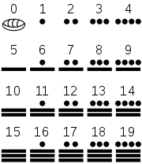
Advances in learning
The Maya created a set of numerals
Also developed a 365-day calendar

Slide 16
What happened to the Maya?
The Maya abandoned many of their cities around 900 A.D.
Archaeologists DO NOT KNOW WHY Maya civilization declined
BUT…

Slide 17
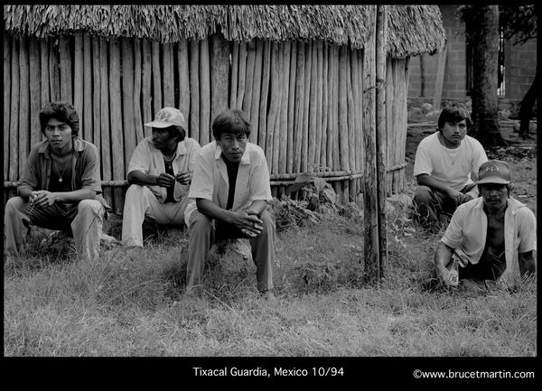
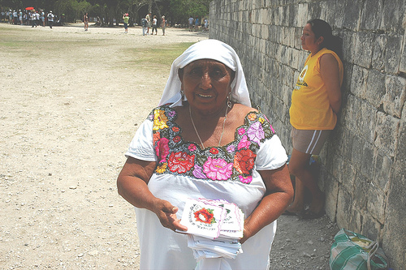
Maya today
…more than 2 million Maya people live in Guatemala and southern Mexico today.

Slide 18
Maya Video Clip
http://www.watchknow.org/Video.aspx?VideoID=12203
This National Geographic video shows the Mayan Pyramids. It is part of the series Lost Temples and it tries to give an answer to the question "Why did the Maya abandon their magnificent city of Chichen Itza?" There is reference to Maya culture.

Slide 19
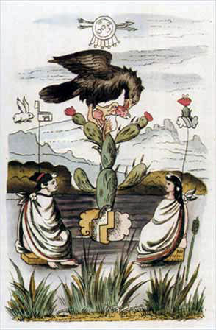
Aztecs

Slide 20
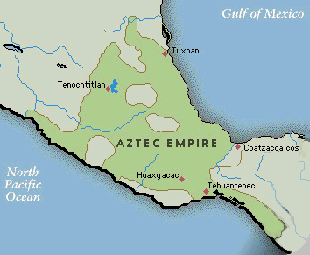
Where did the Aztecs live?
The Aztecs lived in what is known as the Valley of Mexico in central Mexico.

Slide 21
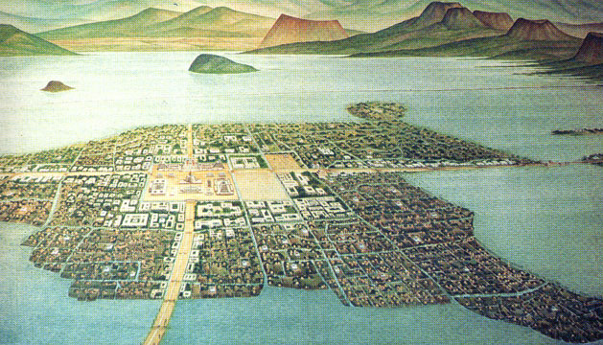
Tenochtitlan
Tenochtitlan was the capital city of the Aztec Empire.

Slide 22
Legend of Tenochtitlan
The gods told the Aztecs to search for an eagle holding a snake in its beak perched atop a cactus. This is where they were to build their capital city. The Aztecs saw this sign on a swampy island in lake Texcoco.

Slide 23
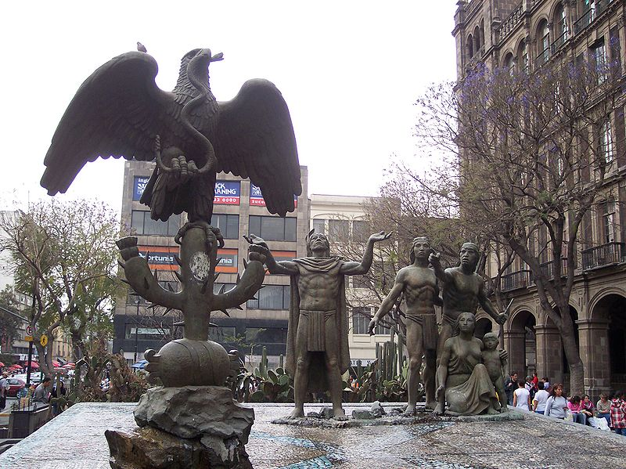
Legend of Tenochtitlan

Slide 24
How did the Aztecs build a city in the center of a lake?
Tenochtitlan was built on an island
It was connected to the mainland by causeways leading north, south, and west of the city.
The city was interlaced with a series of canals, so that all sections of the city could be visited either on foot or by canoe.

Slide 25
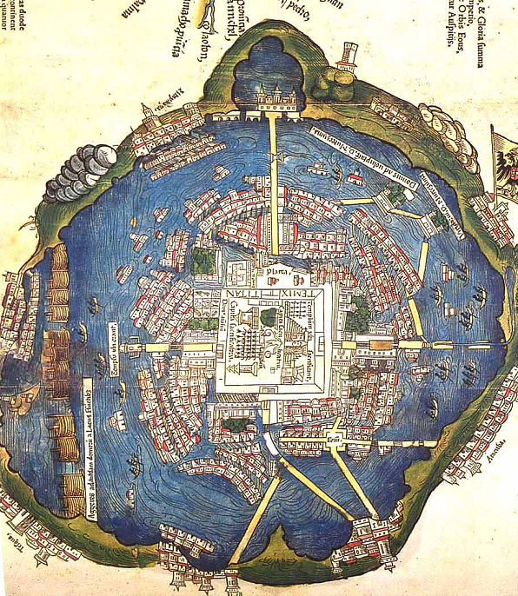
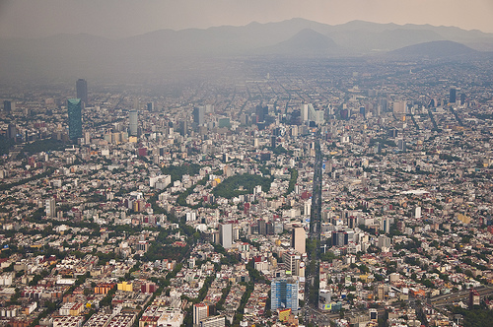
Tenochtitlan
Today, Tenochtitlan is Mexico City

Slide 26
Government
The Aztecs created an empire through conquest
Conquered people and local rulers had to pay tribute to the Aztecs
The Aztecs had an emperor
The Aztec Emperor’s main job was to lead in war

Slide 27
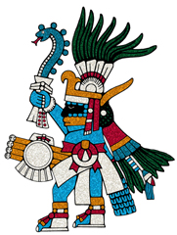
Religion & Mythology
Aztecs were polytheistic
Huitzilopochtli was
the main Aztec god.
(weets se lo poch tlee)
The Aztecs built massive temples and pyramids dedicated to their gods

Slide 28
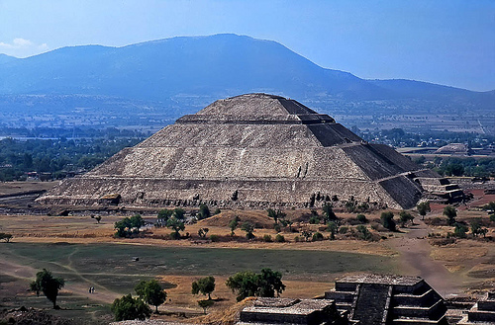
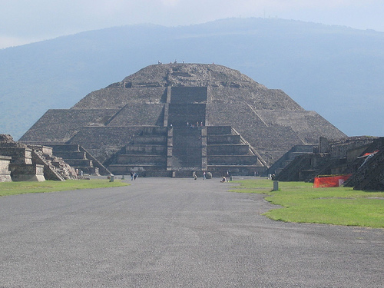
Religion & Mythology
Pyramid of the Sun
Pyramid of the Moon

Slide 29
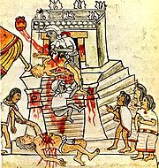
Human Sacrifice
Human sacrifice was a common practice of the Aztecs.
For the reconsecration of Great Pyramid of Tenochtitlan in 1487, the Aztecs reported that they sacrificed 84,400 prisoners over the course of four days.
To give the sun strength to rise
each day, human sacrifices were
offered.

Slide 30
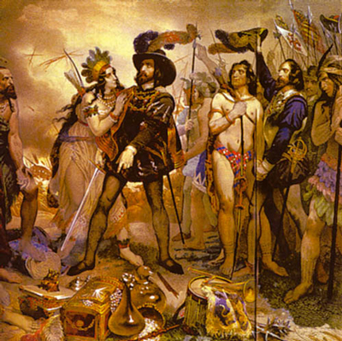
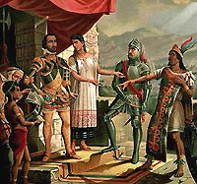
What happened to the Aztecs?
Spanish conquistadors led by Hernan Cortes conquered Tenochtitlan and defeated the Aztecs in 1521.

Slide 31
Aztec Video Clips
“Engineering An Empire”
http://www.watchknow.org/Video.aspx?VideoID=6255
“What the Ancients Did For Us”
http://www.watchknow.org/Video.aspx?VideoID=10964

Slide 32
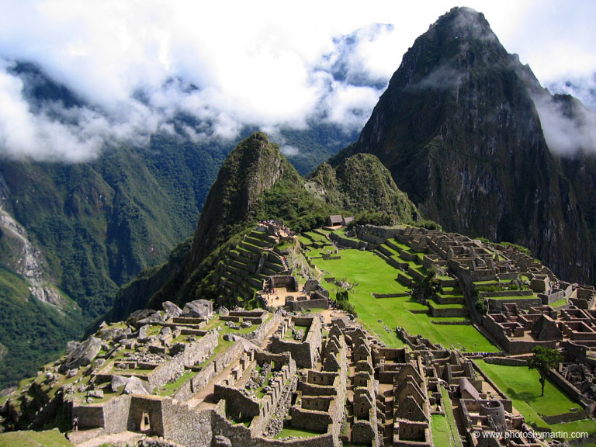
Inca

Slide 33
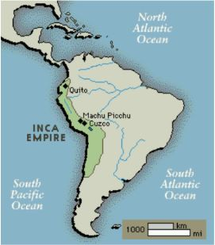
Where did the Inca live?
The Inca controlled an empire in the Andes Mountain region of South America.

Slide 34
Government
The Sapa Inca (emperor) had absolute power.
The emperor claimed to be the son of the sun.
The emperor was also the empire’s religious leader.
The empire was divided into four regions with the capital at Cuzco.

Slide 35
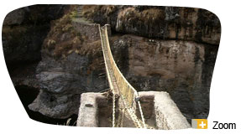
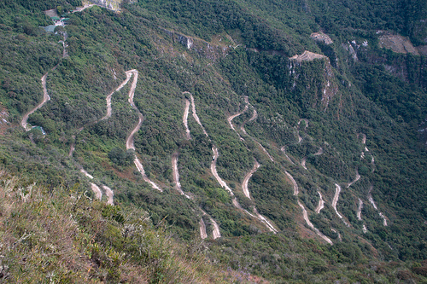
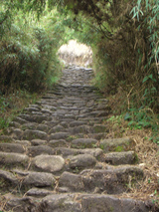
Uniting the Empire
The Inca built a massive road network through mountains and across rivers and gorges.

Slide 36
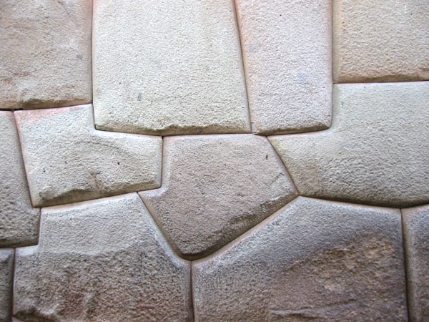
Stonework
The Inca constructed stone temples without using mortars yet the stones fit together so well that a knife would not fit between the stones.

Slide 37
Religion
The Inca were polytheistic.
The primary god was Inti, the sun god.

Slide 38
Religion
Inca believed in reincarnation.
The Inca practiced cranial deformation.
-They achieved this by wrapping tight cloth straps around the heads of newborns to alter the shape of their soft skulls into a cone-like shape.

Slide 39
Medical Advances
The Inca performed successful skull surgery.
The Inca also used medicines to make patients unconscious during surgery

Slide 40
Organization
Each family in a community was assigned a specific job.
Government officials arranged marriages.
The government organized mandatory public service building projects.

Slide 41
What happened to the Inca?
Civil war in the empire broke out...
AND
Smallpox spread, killing much of the Inca…

Slide 42
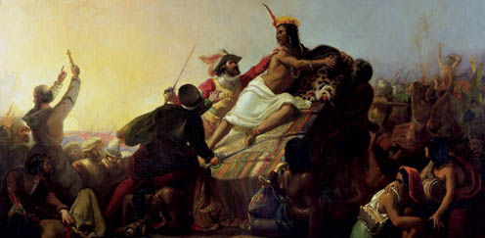
Fall of the Inca
BUT ultimately, it was Spanish conquistadors led by Francisco Pizarro that brought about the fall of the Inca Empire.

Slide 43
Inca Video Clip
http://www.watchknow.org/Video.aspx?VideoID=2301

