Slide 1
Let’s make it a great day!
Monday, October 24, 2015

Slide 2
Jeopardy
Heeeeeeere we go! We are going to play Jeopardy today to prepare for our class
Answer Sheets: you will all receive a blank answer sheet to write down the answers to the questions
Questions will be online by tonight (so you will only have to write in the answer to save time)

Slide 3
The questions
I have ordered the questions a little more in levels of difficulty
The 500 point questions (for the most part) require slightly deeper thinking, and your responses will have to be more thorough

Slide 4
Let’s begin!
THIS
IS
JEOPARDY

Slide 5
Jeopardy
People | Terms | Middle Ages | Changes | Random
100 | 100 | 100 | 100 | 100
200 | 200 | 200 | 200 | 200
300 | 300 | 300 | 300 | 300
400 | 400 | 400 | 400 | 400
500 | 500 | 500 | 500 | 500

Slide 6
People - 100
These were well trained people who usually rode horses
They fought to defend a kingdom or fiefdom
Notes:
Category 1 - 10

Slide 7
People - 200
These people were in charge of a manor
They were given land by a king
Notes:
Category 1 - 20

Slide 8
People - 300
The man who invented the printing press…

Slide 9
People - 400
Describe what a renaissance man is

Slide 10
People - 500
Who wrote The Prince, and what was the essay about?

Slide 11
Terms- 100
What does the term “Renaissance” mean?

Slide 12
Terms - 200
What does ‘secular’ mean? What does it describe?

Slide 13
Terms - 300
Why did the Church look at humanism as a bad thing?

Slide 14
terms- 400
Dante Alighieri is said to have written his famous work, Inferno, in the ‘vernacular.’
What does that mean, and what is the American vernacular?

Slide 15
Terms- 500
What does the term “medieval” mean?
Where did the word come from?

Slide 16
Middle Ages- 100
Describe what a manor is.

Slide 17
Middle Ages- 200
Explain what the coat of arms was used for.

Slide 18
Middle Ages- 300
The life of a serf was not exactly known to be much fun.
What were a serfs duties, and who did they answer to?

Slide 19
Middle ages - 400
What was the code of chivalry? And, who was it intended for?

Slide 20
Middle Ages- 500
Which event signified the beginning of the Middle Ages?
What event ended the Middle Ages?

Slide 21
Changes- 100
What author/playwright defines the Renaissance period in England (known as the Elizabethan Age)?

Slide 22
Changes- 200
What artistic term changed the way portraits were drawn/painted by utilizing foreground and background?

Slide 23
Changes- 300
Copernicus and Galileo were particularly interested in studying the stars, sun, moon, and other ‘celestial bodies.’
What is the term they created for the major scientific discovery about the universe? (The Catholic Church was NOT happy about it)

Slide 24
Changes- 400
The Bubonic Plague changed life completely in Europe
What are two things that the Plague changed about life in Europe?

Slide 25
Changes- 500
Castles and knights did not exist throughout most of the Middle Ages (despite popular belief).
What made Europe build castles and train knights?

Slide 26
Random- 100
What does the term feudalism mean?

Slide 27
Random- 200
What was the Scientific Method?

Slide 28
Random- 300
During the Renaissance, Europe had a return to certain cultural aspects.
Which cultures did they return to?

Slide 29
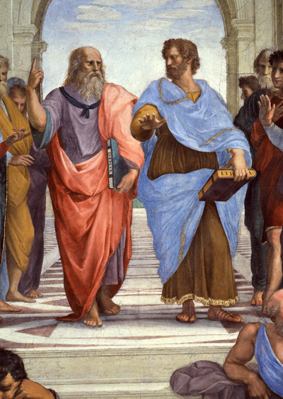
Random- 400
Explain the action of
This picture:

Slide 30
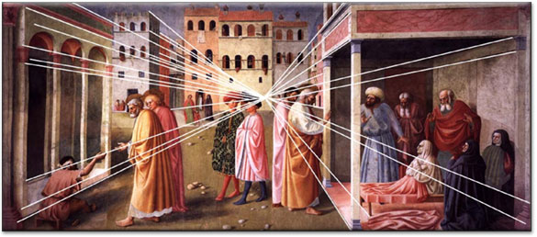
Random- 500
What is this picture an example of:

