Slide 1
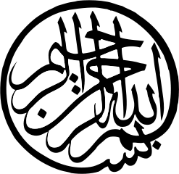
The Rise of Islam

Slide 2
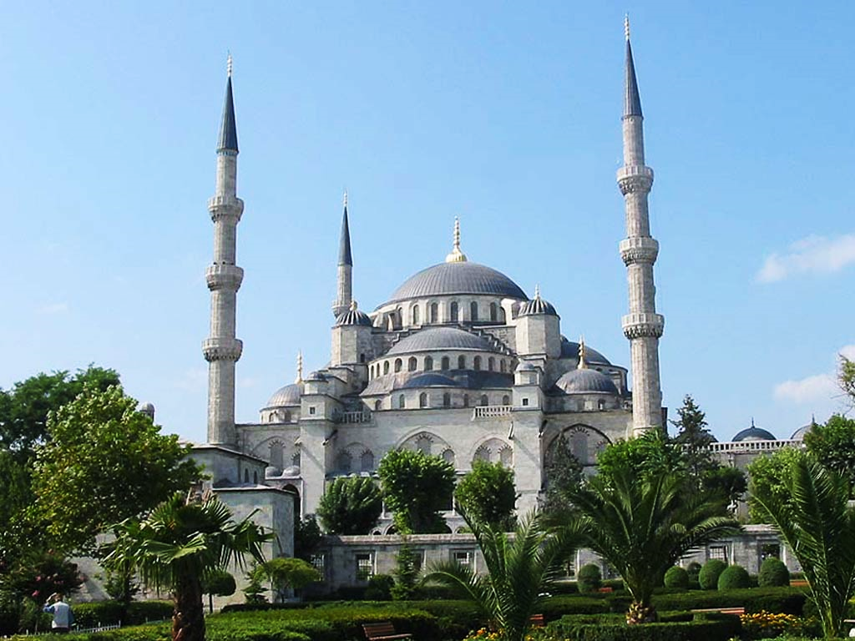
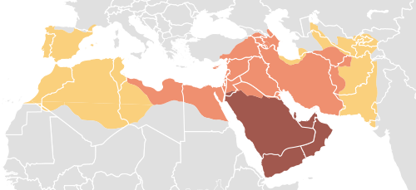
TABLE OF CONTENTS
Part I
Part II
Introduction to Islam
Expansion of Islam

Slide 3
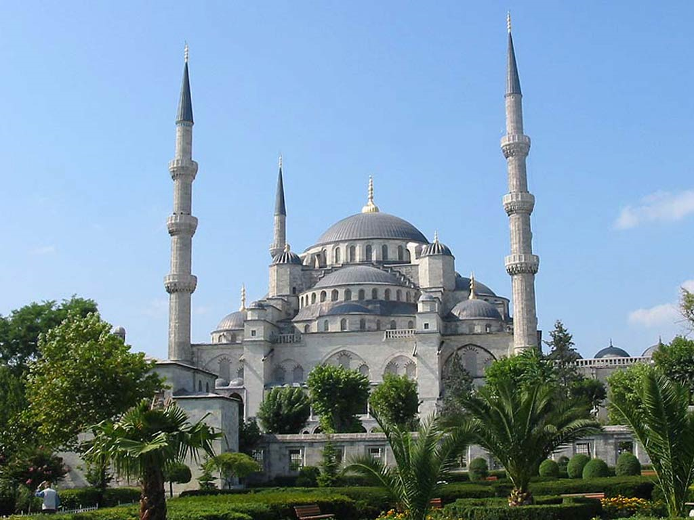
Introduction to Islam

Slide 4
Islam
The term Islam means “to submit”
Religion | Islam | “To Submit”
Follower | Muslim | “One Who Submits”

Slide 5
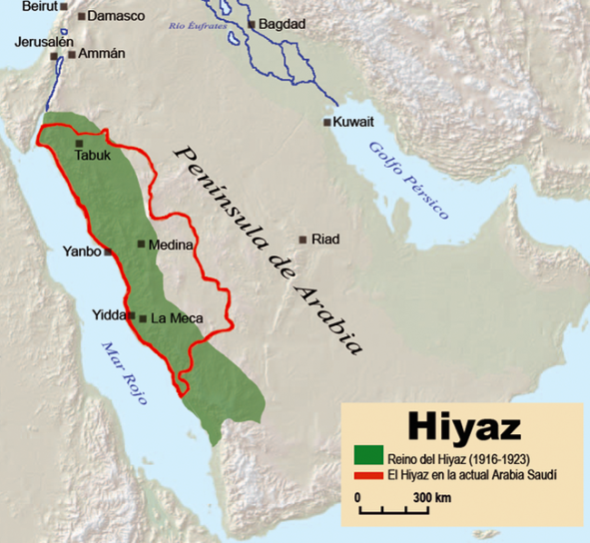
Hejaz
Region of Islam’s holy places
Trade Routes

Slide 6
Muhammad
b. 570 A.D. in Mecca
Trading and religious center
Kaaba
Led trade caravans through the Hejaz
Exposed to diverse people and ideas

Slide 7
Islam
Allah (God)
Muslim
One who submits
Hijrah
622 A.D.
Flight: Mecca → Medina
Qur’an [Recitations]
Dictated to Muhammad by Gabriel

Slide 8
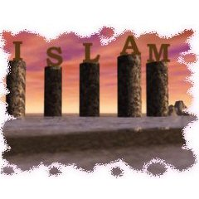
Five Pillars of Islam

Slide 9
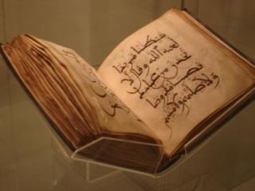
1st Pillar: Profession of Faith (Shahada)
TWOFOLD:
God (Allah) is One
Muhammad is the final prophet
For Muslims, the Qur’an is the
ultimate proof of this declaration.

Slide 10
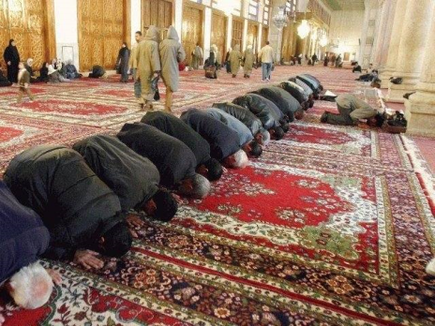
2nd Pillar: Praying (Salat)
Salat is the ritual of prayer
Muslims pray five times a day (dawn, noon, afternoon, sunset, evening) in the direction of Mecca.

Slide 11
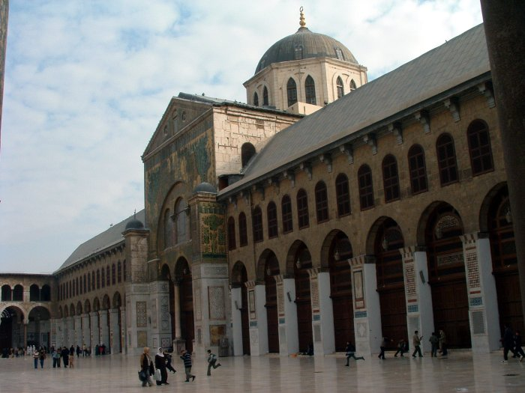
The Umayyad Mosque

Slide 12
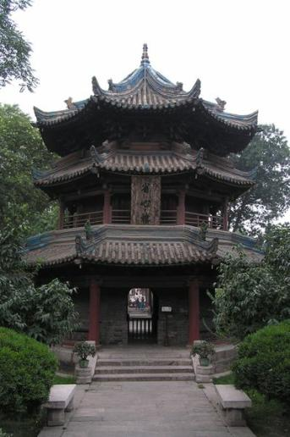
Great Mosque of X’ian

Slide 13
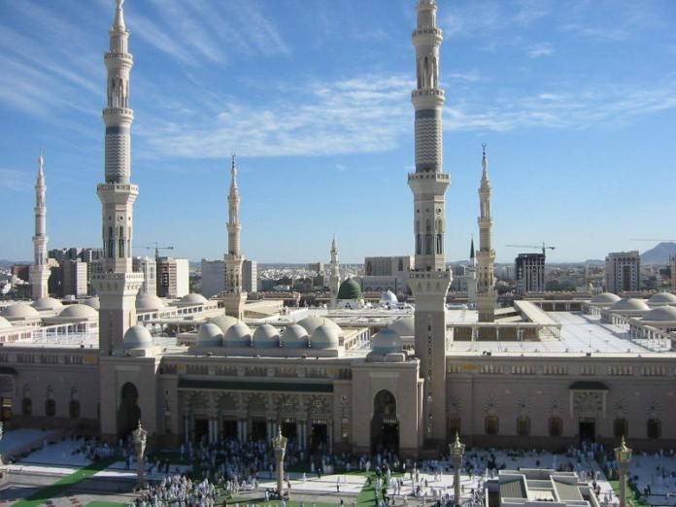
Masjid Nabawi (The Prophet’s Mosque)

Slide 14
3rd Pillar: Zakat (Charity)
Piety and charity are important aspects of Islam. All Muslims are required to be charitable to those who are less fortunate then themselves.

Slide 15
4th Pillar: Ramadan (Fasting)
Ramadan is the ninth month of the Islamic Lunar Calendar.
During this month, Muslims will refrain from all food, drink, tobacco, etc., during daylight hours
Pregnant women, the elderly, and young children do not have to fast.
Ramadan Dates
Easter Dates
Interesting Article:
http://www.islamfortoday.com/ramadan09.htm

Slide 16
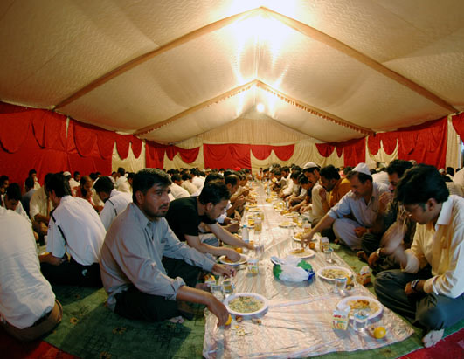

Slide 17
5th Pillar: The Hajj (Pilgrimage to Mecca)
Muslims are required to travel to Mecca at least once during their life time. The Pilgrimage is done during the 12th Lunar Month (Dhul Hijjah).
At Mecca, they will perform a variety of rituals involving the Kaaba and the Black Stone.
The Pilgrimage was performed by Muhammad at the end of his life.

Slide 18
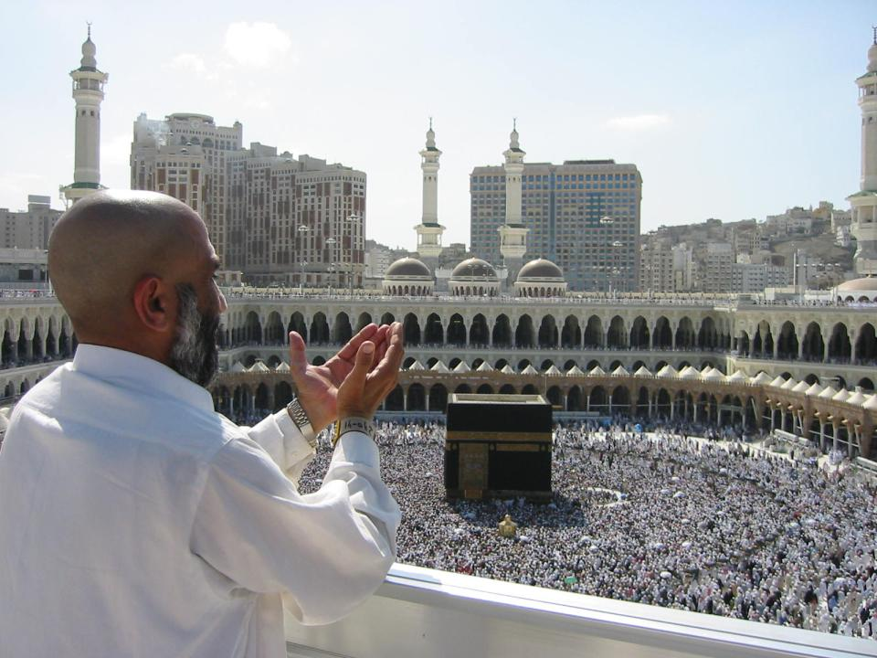

Slide 19
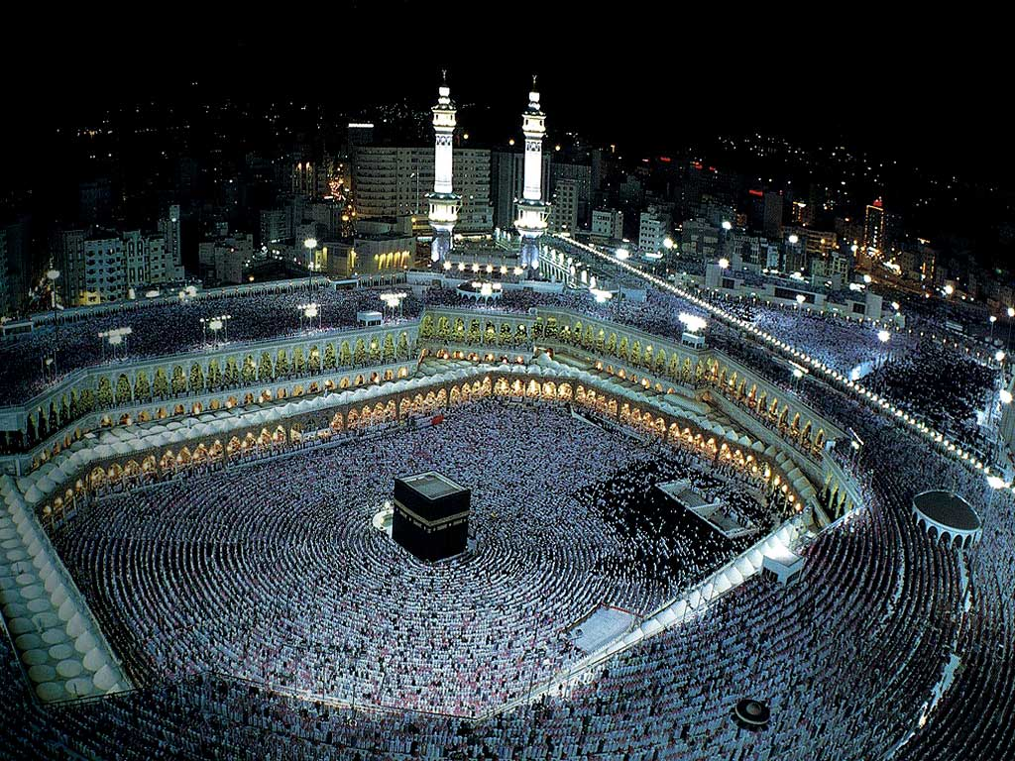

Slide 20
The Black Stone Close-up

Slide 21
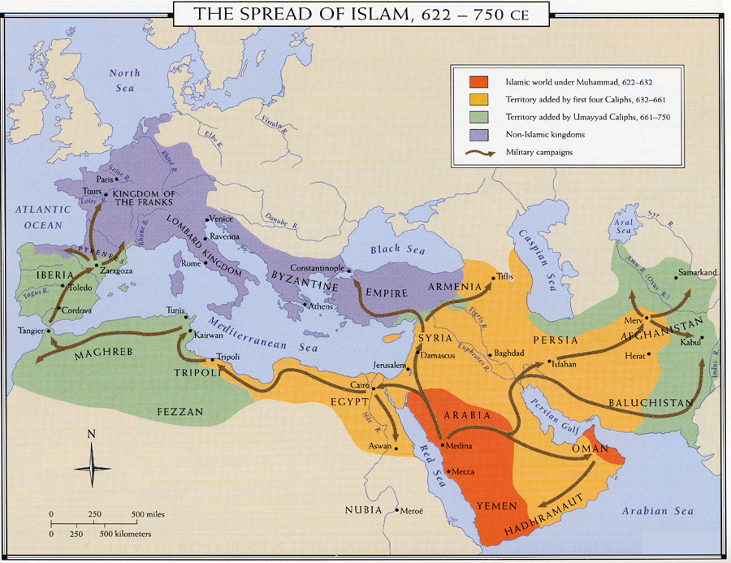
The Expansion of Islam and the limits thereof
SC Standard GS-2
Indicator(s): 2.1, 2.2

Slide 22
Conquest
Conquest and Conversion
“People of the Book” not forced to convert (Jews and Christians)
Conquests stretched from Spain in the West to Persia in the East
Moors – Muslim conquerors of Spain

Slide 23
Sieges of Constantinople
(674-678, 717-718)
Tours (732)
Source: http://www.wall-maps.com/Classroom/HISTORY/World/Universal/World-history-universal.htm

Slide 24
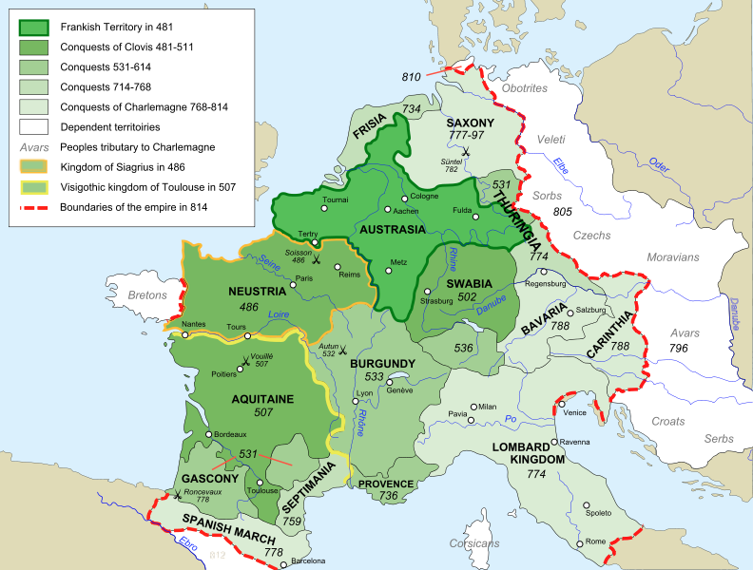
The Franks
Clovis (466-511)
First King of the Franks
Battlefield Conversion to Christianity

Slide 25
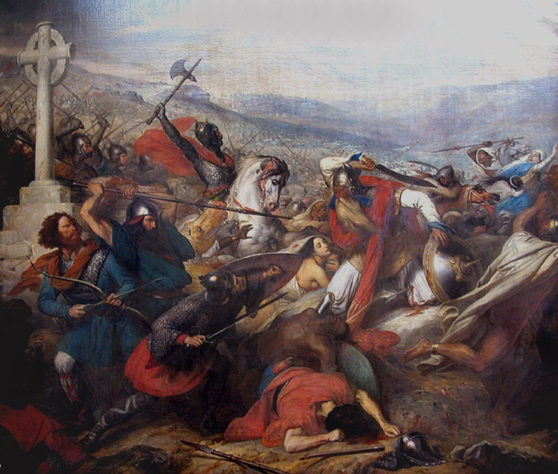
Charles “The Hammer” Martel
Mayor of the Palace
732 - Battle of Tours
Muslim expansion halted
Steuben, Bataille de Poitiers, 1837

Slide 26
Steuben, Bataille de Poitiers [Tours], 1837

Slide 27
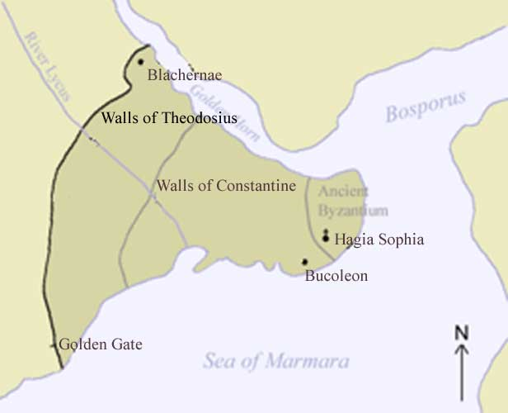
Byzantine-Arab Wars
“All roads lead to Rûm”
-- Arab Saying
WALLS
NAVY

Slide 28
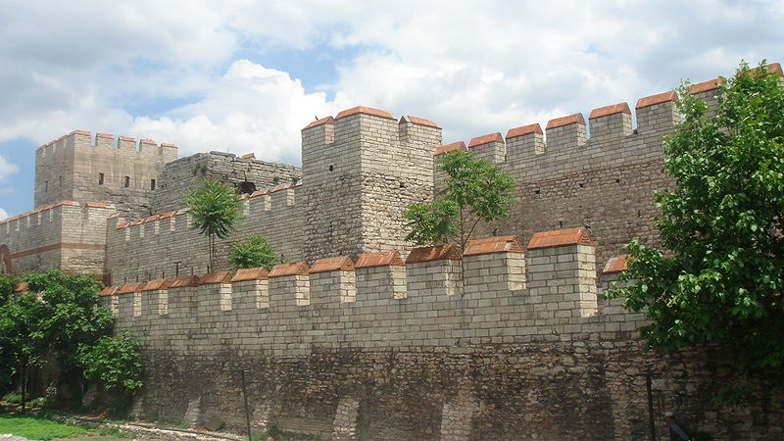
Theodosian Wall (Constantinople)
More: http://www.mlahanas.de/Greeks/Medieval/war/WallsOfConstantinople.html

Slide 29
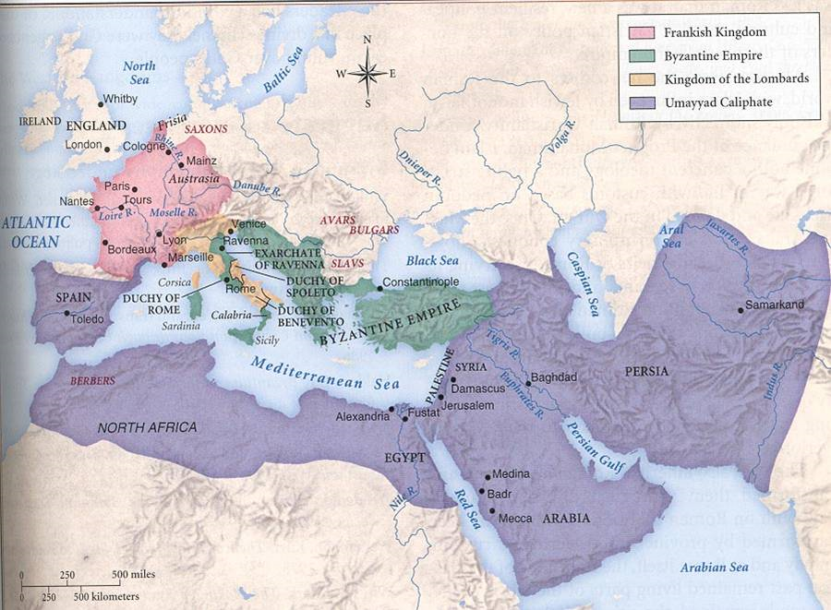
Credit: http://espliego.files.wordpress.com/2008/03/islam-map1ref1.jpg

Slide 30
Islamic Golden Age (c. 700-1200 A.D.)
Literature:
Arabian Nights (10th c.)
Medicine:
Postmortem Autopsies on Humans
Forbidden by Romans
Experimental Surgery
Germ Theory
Disproved Humorism
Chemistry
Distilled Liquors
Perfume
An Arabic manuscript describing the eye, dating back to the 12th century

Slide 31
For more videos and instructional materials, visit

